Slide 1
VISIBLE LIGHT COMMUNICATION
DONE BY:
M.K.CHANDRAVEL(210421106016)
KRISHNA SRIDHAR (210421106046)
S.DEEPAK CHAKKRAWARTHY(210421106019)

Slide 2
OBJECTIVES
To provide high-speed data transmission
Energy-efficient communication using visible light
Ensure security
Enable indoor positioning
Coexist with other technologies
To find applications in healthcare
underwater communication,
IoT integration

Slide 3
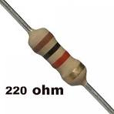
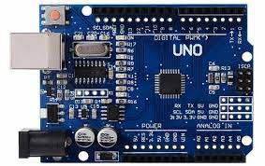
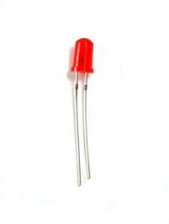
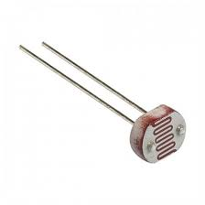
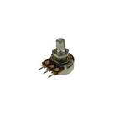
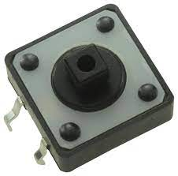
COMPONENTS USED:
Resistor 220 ohm
Arduino UNO
Rotary potentiometer (generic)
LED (generic)
Tactile Switch, Top Actuated
LDR 5M ohm

Slide 4
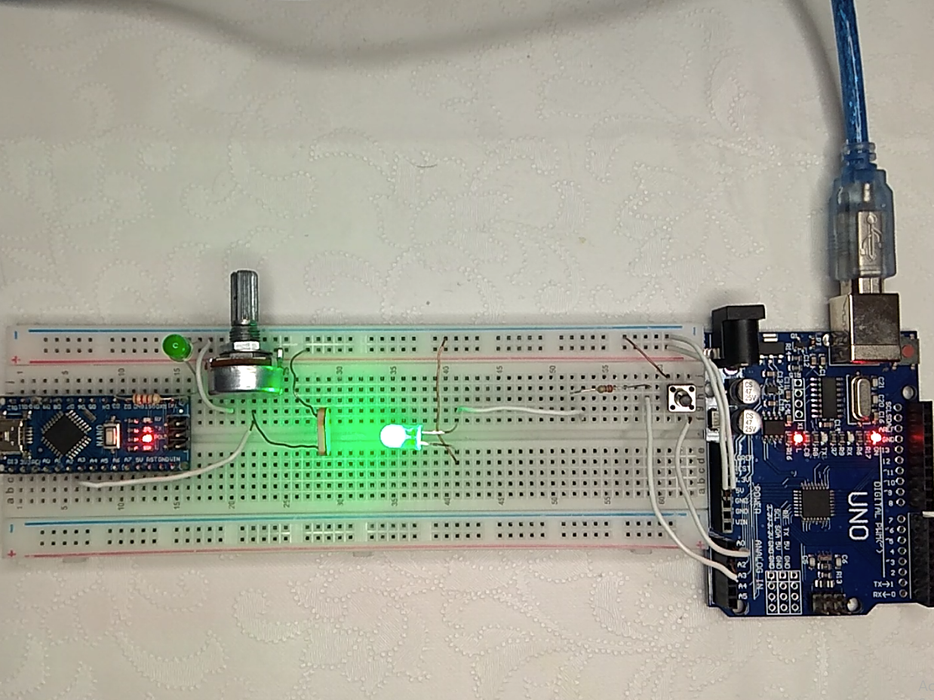

Slide 5
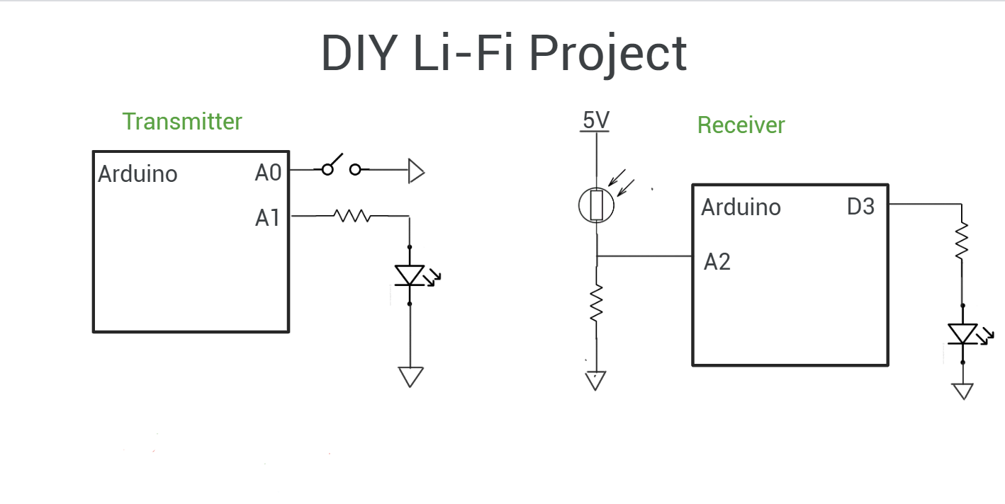



Slide 6
FUTURE SCOPES OF VLC
High-Speed Wireless Internet:
VLC has the potential to complement or even replace traditional Wi-Fi in indoor environments. With higher data rates and reduced interference, VLC can offer faster and more reliable wireless internet access.
Smart Cities:
VLC can be a key component of smart city infrastructure. Streetlights and traffic lights equipped with VLC technology can transmit data to vehicles, pedestrians, and sensors, enhancing traffic management, public safety, and energy efficiency.

Slide 7
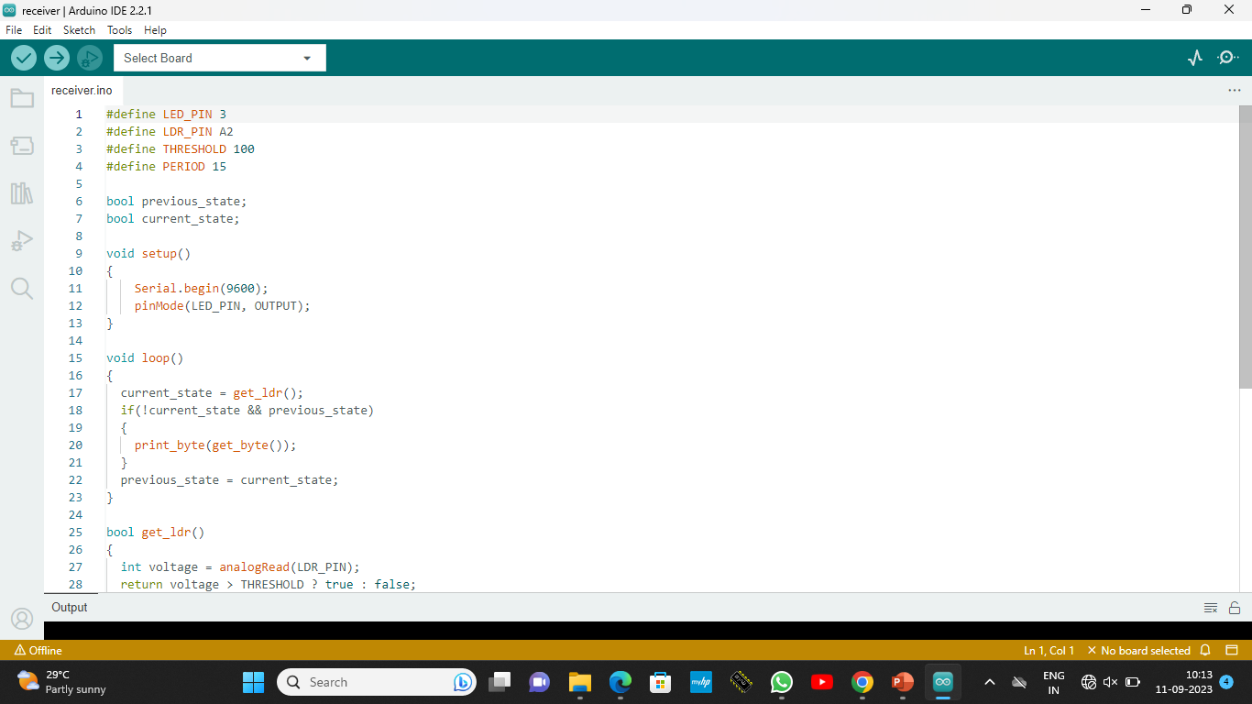
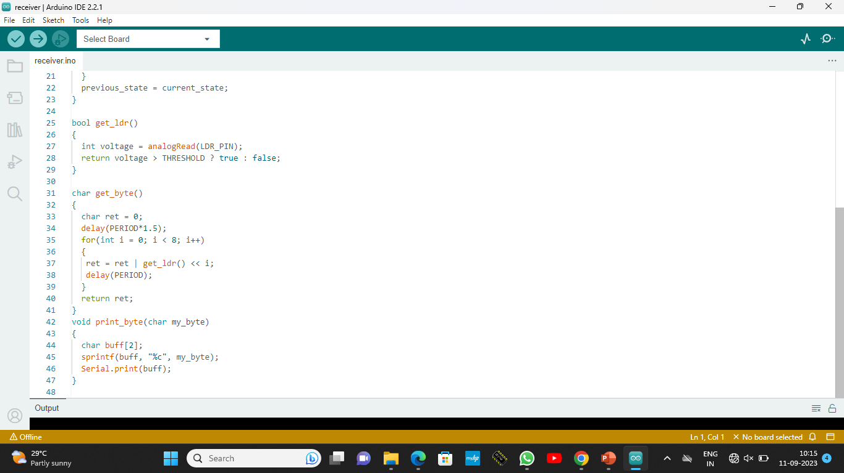
Receiver code:

Slide 8
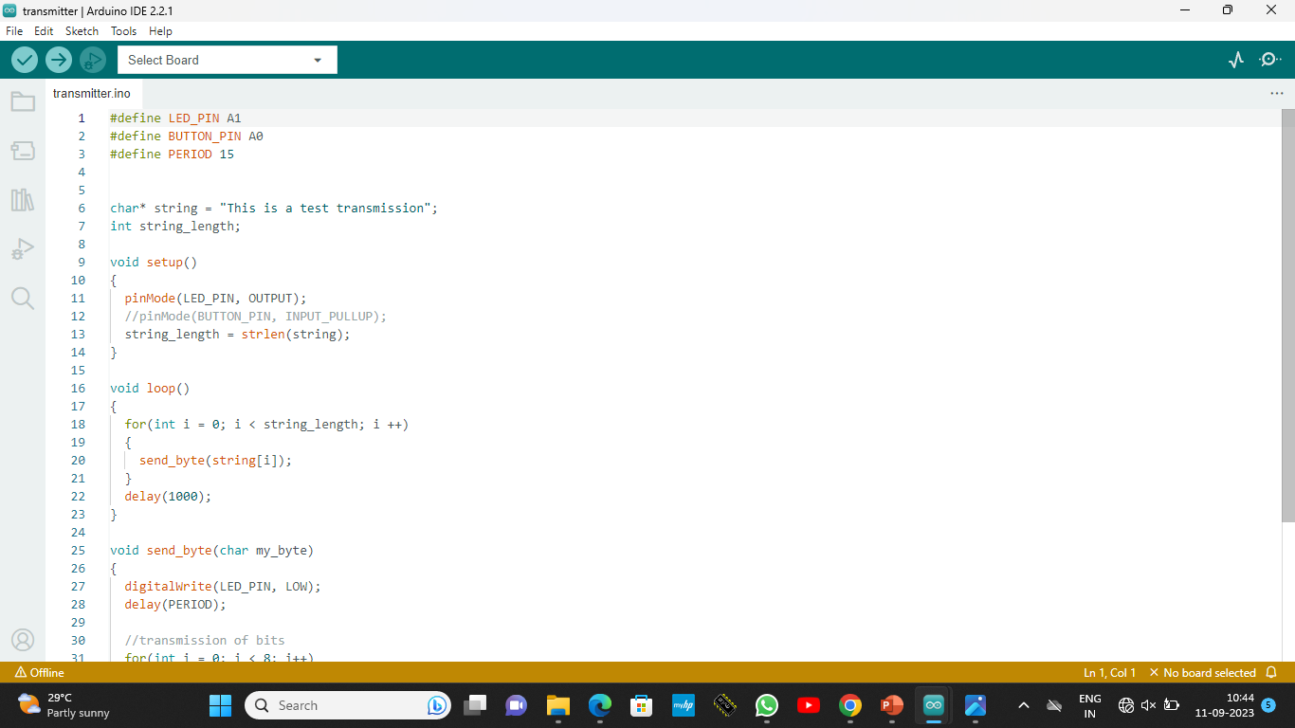
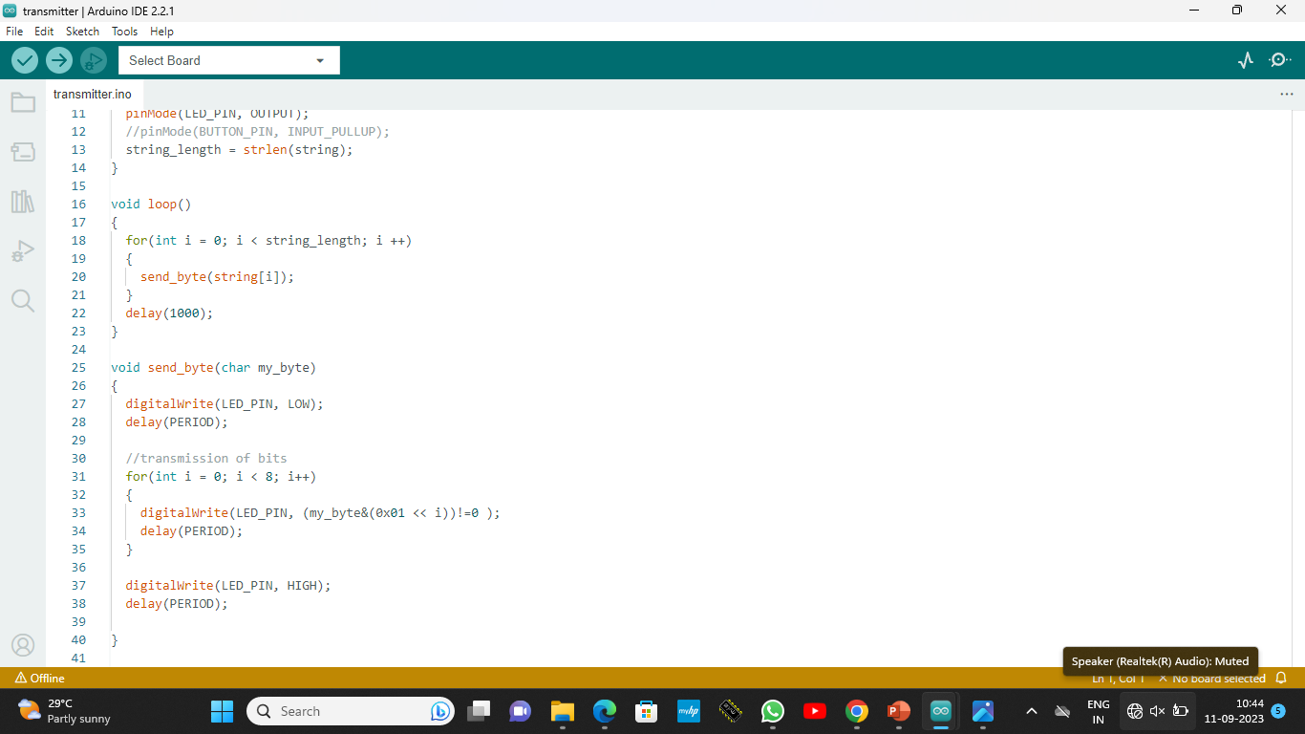
Transmitter code:

Slide 9
Thank you

